Slide 1
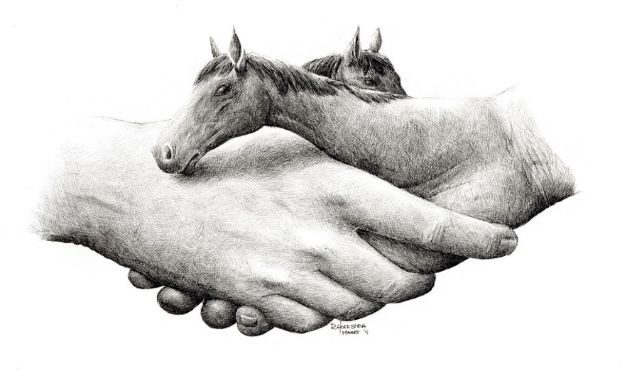
TRAAC: Therapeutic Riding Assessment for Adults and Children
Cheryl H. Coughlin, OTD, OTR/L
July 21, 2023
Horse and Human Research
Foundation Conference
Hackettstown, NJ

Slide 2
Who am I?
Developed this assessment to address EAAT students
Executive director of accredited premier riding center
Presented at community, state, regional, & national conferences
Doctor of Occupational Therapy

Slide 3
Mission/ Vision of TRAAC :
Universal standardized assessment design Developed for EAAT English/Western riding programs
Utilizes uniform terminology, scoring, techniques
Addresses activities related to riding (i.e.-grooming, tack care, etc. )
Logic model Tracks short/long term goals
Provides outcome measures
Provides hard data for grant writing
Demonstrates the impact and importance of therapeutic riding
Criterion- based Utilizes objective data
Follows the developmental sequence
Assesses life span of a rider-include work habits, social skills in natural environment
Utilizes evidence-based research
TRAAC Provides Data: Initial evaluation (PATH Intl. Standards for Certification and Accreditation; ESK2)
Outcome measure-Goal Attainment Scale(G.A.S.)
Session/progress assessment (PATH Intl. Standards for Certification and Accreditation; ESK1)

Slide 4
Areas assessed
OT Progress Note- Nikhil Brown
03/28/2019
Participants; Nikhil, Ms. Brown, Nikhils grandmother (Sharon) Cheryl Coughlin, OT
Developmental sequence
Process –sensory/physical of initiation, sustaining, completing/transitioning
Social/Cognition-Matching, observing, modeling with peers & staff
Habit routines – time and space orientation using speed and production with practice and repetition

Slide 5
How do we learn?
Concrete Experiences
Reflective Observation
Abstract Conceptualization
Active Experimentation
One of the most influential models was proposed by David Kolb ,the Experiential Learning Theory (ELT) in 1984. It is still seen as one of the most widely used learning styles model. ELT is based on the assumption that people learn by doing or from direct experience.

Slide 6
Who can perform assessment
Important players-instructors, parents, educators, community
Therapeutic Riding Team-instructors, volunteers, related service providers

Slide 7
How – Performance skills
Person
Behavior
Situation
Pace
Speed
Productivity

Slide 8
Rating Scale | Criteria
1 | Not Tested: did not evaluate participant on the objective during the assessment.
2 | Unable to Initiate: participant unable to initiate the objective as stated.
3 | Initiates: participant able to initiate the objective.
4 | Partially Completes: participant able to partially complete the set objective.
5 | Completes: participant able to initiate, maintain and complete the task as requested.

Slide 9
Results -
Initial assessment to give baseline where rider is starting
Outcomes for session – where they are at beginning of session and end of session
Outcomes over time – where are they in 8 weeks, 16 weeks…
Generalizations/adaptations for equine skills and for life skills which can be foundational skills for pre-vocation/vocation skills

Slide 10
Why is this important for your program and the rider/client/investors/grant givers…
Provide evidence-based data
Follows logic plan for grants
Provides numerical and developmental sequence for goal and progress tracking of individual
Enact change with action (Skunk, 2012)
Supports acquisition of skills-knowledge, rules , attitudes (mindfulness), strategic belief (resilience)

Slide 11
Case Study
Client | Diagnosis | Initial |  | Outcome
Tim Stella Danny | TBI Cerebral Palsy Wagers Syndrome | Physical/Cognitive Physical Physical/Cognitive/ Behavioral |  | Full Time Employed; Family Part time employment; Single Day support program; Group Home

Slide 12
How to implement this into your program
Question
Question value of need for assessment
Provide
Provide feedback with solutions
Present
Present information to local program stakeholders
Enjoy
Enjoy a creative tool for your profession

Slide 13
CHERYL H. COUGHLIN OTD, OTR/L
ccoughlin2011@gmail.com | 703-887-3014
PROFESSIONAL PROFILE: A passionate Occupational Therapist with over 20 years of professional pediatric experience with a focus on early intervention and medically complexities in home, school, and community-based settings. Licensed in the state of Virginia with several specialized certifications acquired to enhance the occupational performance skills of clients, supporting their knowledge and resilience throughout their life span.
Doctor of Occupational Therapy, 2011 Bachelor of Science in Occupational Therapy, 1979

Slide 14
References
Bass, M. M., Duchowny, C. A., & Llabre, M. M. (2009). The effect of therapeutic horseback riding on social functioning in children with autism. Journal of Autism and Developmental Disorders, 39(9), 1261-1267. doi:10.1007/s10803-009-0734-3
Champagne, D., & Dugas, C. (2010). Improving gross motor function and postural control with hippotherapy in children with Down syndrome: Case reports. Physiotherapy Theory and Practice, 26(8), 564-571.
Cuypers,K., DeRidder,K., Strandheim,A., (2011). The Effect of Therapeutic Horseback Riding on 5 Children with Attentional Deficit Hyperactivity Disorder: a pilot study. Journal of Alternative Complement Medicine.,17(10): 901-8. doi: 10.1089/acm.2010.0547.
Downs, J., Jacoby, P., Leonard, H., Epstein, A., Murphy, N., Davis, E., Reddihough, D., Whitehouse, A., Williams, K., 2019. Psychometric properties of the Quality of Life Inventory-Disability (QI-Disability) measure. Quality of Life Research. Mar;28(3):783-794. doi: 10.1007/s11136-018-2057-3. Epub 2018 Nov 20
Gabriels, RL, Pan Z., Guerin, NA Dechant, B, Mesibov, G. 2018. Long-Term Effect of Therapeutic Horseback Riding in Youth With Autism Spectrum Disorder: A Randomized Trial. Front Vet Sci. 2018; 5:156. Epub Jul.16.
Garcia,Ga., Rodriguez-Jimenez, M., Guerrero-Barona, E., Rubio-Jimenez, JC., Garcia-Pena, I., Moreno-Manso, JM. (2016). Benefits of an experiential program of equestrian therapy for children with ADHD. Res. Developmental. Disability. Dec.2016. 59:176-185. doi: 10.1016/j.ridd.2016.09.003. Epub 2016 Sep 7.
Lechner, H. E., Kakebeeke, T. H., Hegemann, D., & Baumberger, M. (2007). The effect of hippotherapy on spasticity and on mental well-being of persons with spinal cord injury. Archives of Physical Medicine and Rehabilitation, 88(10), 1241-1248. doi:10.1016/j.apmr.2007.07.015
Macauley, B. (2007, April). Effects of equine movement on attention and communication in children with autism.
Shurtleff, T. L., Standeven, J. W., & Engsberg, J. R. (2009). Changes in dynamic trunk/head stability and functional reach after hippotherapy. Archives of Physical Medicine and Rehabilitation, 90, 1185-1195. doi:10.1016/j.apmr.2009.01.026
Lee,O., Park,M., Jang,K., Park, Y., (2017). Life Lessons after ‘classes: Investigating the influence of an afterschool sport program on adolescents’ life skills development. International. Journal of Qualitative Study of Health Well-Being. ‘2017 Dec; 12(1): 1307060. doi:10.1080/17482631.2017.1307060.

Slide 15
References for TRAAC Assessment
Assessment of Motor and Process Skills(AMPS)-standardized internationally
Use: 2 years and older; any diagnosis
Perform familiar task in a community setting
Measures how motorically engage in task and how process steps to the task
Designed by Center for Innovative Solutions
School Function Assessment (SFA)- standardized criteria- based assessment
Use: 5 years-14years
Perform school-based tasks in school setting
Measures : (a) level of participation in six major activity settings, (b) task supports, such as assistance and adaptations provided to the student, and (c) activity performance.
Designed by Wendy Coster, PhD,OTR/L,, Theresa Deeney, EdD, Jane Haltiwanger, PhD, Stephen Haley, PhD, PT. 1998.

Slide 16
Contributors:
Debi Alexander- JD; former executive director of Rainbow Riding Center
Tammy Blake-OTD,OTR/L; transition specialist with school age students
Mary Flood-USDF/FEI dressage rider, trainer, instructor (go both directions; loose reins)
Barbie Ford-M.A., NCC, CTRI; Executive Director of Untamed Spirit; Resident in Counseling; James Brady Award Recipient
Eitan Beth-Halachmy-Western Dressage (slow and defined transitions, light reins)
Redmer Hoekstra- 2011;#6 Horse & Human Hands Drawing
Patricia Laverdure-OTD,OTR/L, BCP, Assistant Professor –Virginia Commonwealth University
Deborah Rose-PT, DPT, Board Certified Clinical Specialist in Pediatric Physical Therapy
Jan Spink- M.A.; Author of Developmental Riding Therapy; James Brady recipient

Slide 17
Contributors continued:
Jane Steele-LPTA; research-based CPT codes regarding Physical Therapy
TRAV Centers-Loudon, NVTRP, Rainbow, SPIRIT, Dream Catchers, SPROUT, Ride with Pride
Jean Tebay-M.S.; author of Therapeutic Riding/Strategies for Instruction Part I, “mother of HPOT” (AHA)
Mark Wonderly- Hunter/Jumper Judge, trainer, consultant to competition riders
Marjorie Youngs- M.Ed.; executive director of Blue Ridge TR center
Richard Zulewski-IT support
Friend’s homes- “to write-in quiet”

